Slide 1
SALES PREDICTION USING MACHINE LEARNING ALGORITHIM RESOURCE BY DATA
Team Submission TEAM ASSIGNERS
CODEREAPER AKASH
AKANSHA
RAMESHWAR

Slide 2
Contents
Data Preparation & Data Wrangling.
Feature Engineering.
Splitting Data into Train and Test.
Regressing Data using Grid Search and Random FO Regressor.
Plotting the Map Graph Predictions.

Slide 3
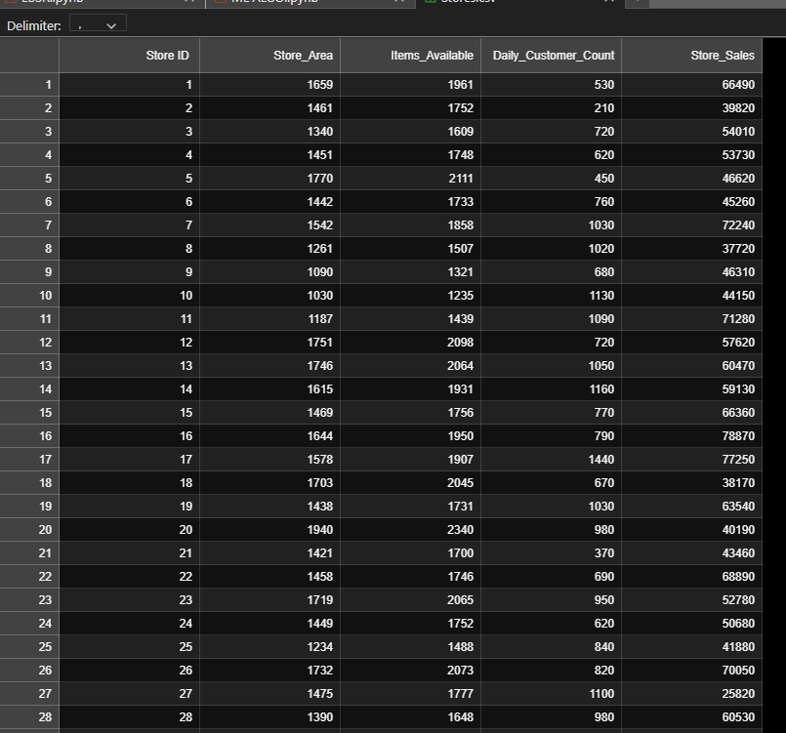
Data Preparation.
Data Set is Collected through OPEN ML repository.
Data have 896 Records and 5 Columns.
Consists of String and Integers, Formatted.

Slide 4
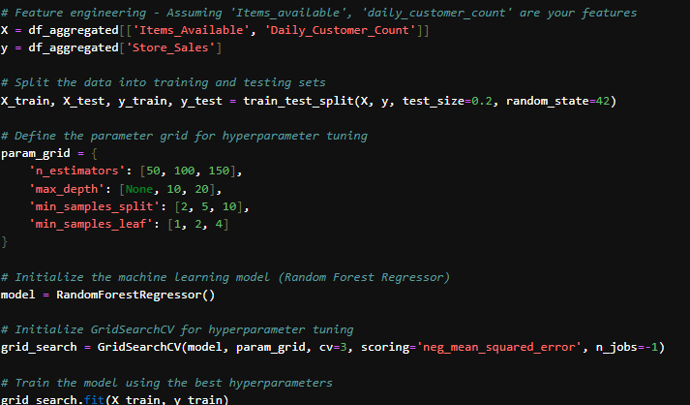
Feature Engineering.
Data have Some feature related to Correlation Magnitude and Distributions Mark Set, Grid Searching Hyper Parameter & Feature Correlations between independent variable and Scalers of Dependent Variable & Fitting the Data

Slide 5
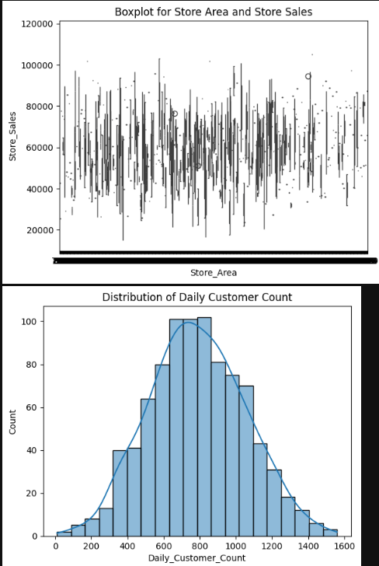

Slide 6
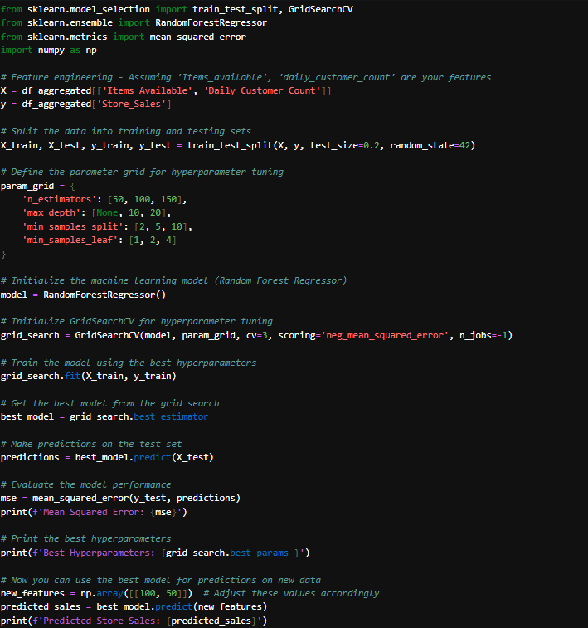
Regressing Data using Grid Search and Random FOREST Regressor.
When using random forests, grid search can be employed to tune hyperparameters such as the number of trees in the forest, the maximum depth of the trees, the minimum number of samples required to split a node, etc. Grid search helps to identify the optimal combination of hyperparameters that maximizes the performance of the random forest model on the given dataset. By exhaustively searching through the specified hyperparameter space, grid search can assist in fine-tuning the rando forest model for improved performance and generalization. for improved performance and generalization.

Slide 7
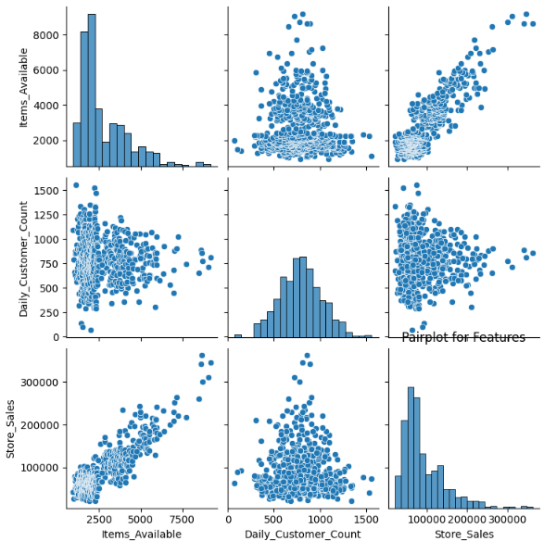
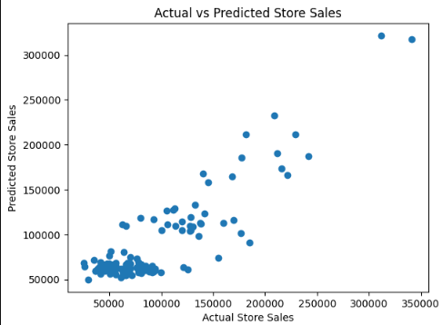
Plotting the Map Graph Predictions.

Slide 8
THANK YOU

